Slide 1
Campus Placement Recruitment System

Slide 2
AIM OF THE PROJECT
The proposed system enables students to search for upcoming placement opportunities, apply for positions that match their qualifications and interests, and conveniently view the results of placement processes.
Additionally, even after graduating, students can access and review placement details, providing ongoing career support. This platform not only simplifies placement processes but also fosters transparency, accessibility, and improved communication between all stakeholders. It stands as a testament to the commitment to empower students in their pursuit of meaningful and rewarding careers.
With just a few clicks, students can easily search for upcoming placement drives, explore job openings that match their qualifications and
This platform brings together students, educational institutions, and potential employers on a single platform, fostering meaningful connections and collaboration. From timely notifications to real-time updates on placement processes, the system ensures that everyone is on the same page, facilitating a seamless recruitment experience for all stakeholders. interests, and conveniently app
Employers, too, benefit greatly from the Campus Placement Recruitment System. By tapping into a pool of talented and qualified individuals, employers can easily find the perfect match for their job openings. ly for positions.

Slide 3

SOFTWARE AND HARDWARE REQUIREMENTS
HARDWARE REQUIREMENTS:
Processor : Intel 5
Installed memory (RAM) : 4 GB
Hard Disk : 500 GB
Operating System : Windows
SOFTWARE REQUIREMENTS:
Front End: HTML5, CSS3, Bootstrap
Back End: PHP 8.1, MYSQL
Control End: Angular Java Script
TOOLS:
IDE: Android Studio
Android Emulator
xampp-win64-8.1
PHP TOOLS:
xampp-win64-8.1

Slide 4
EXISTING SYSTEM
The placement process is usually done manually and using paper, with physical job postings, application forms, and notices on bulletin boards.
Students have limited access to comprehensive information about upcoming placement opportunities, such as job descriptions, company details, and eligibility criteria.
Applying for placements typically involves filling out physical forms and submitting them to the placement cell, which can cause delays and inefficiencies.Students often do not have real-time access to placement updates, interview schedules, and results, resulting in uncertainty and missed opportunities.

Slide 5
DISADVANTAGES OF EXISTING SYSTEM
The placement process is often manual and paper-based, involving physical job postings, application forms, and notices on bulletin boards.
Students have limited access to comprehensive information about upcoming placement opportunities, including job descriptions, company details, and eligibility criteria.
Applying for placements typically requires filling out physical forms and submitting them to the placement cell, leading to delays and inefficiencies.
Students often lack real-time access to placement updates, interview schedules, and results, leading to uncertainty and missed opportunities.
The existing system may lack a structured feedback mechanism, making it challenging for students to receive feedback on their placement attempts.

Slide 6
PROPOSED SYSTEM
The proposed system will be a fully digital platform accessible to administrators, placement staff, and students. It will provide detailed information on placement opportunities, including job descriptions, company profiles, application deadlines, and eligibility criteria.
Students can apply for placements online, eliminating physical forms and streamlining the application process. Real-time updates on placement activities such as interview schedules, shortlisted candidates, and results will be provided.
Users (students) can create and manage profiles that store their academic records, resumes, and preferences to make the application process easier.

Slide 7
ADVANTAGES OF PROPOSED SYSTEM
The proposed system will be entirely digital, providing an online platform accessible to administrators, placement staff, and students.
The system will offer detailed information about placement opportunities, including job descriptions, company profiles, application deadlines, and eligibility criteria.
Students can apply for placements online through the system, eliminating the need for physical forms and streamlining the application process.
The platform will provide real-time updates on placement activities, including interview schedules, shortlisted candidates, and results.
Users (students) can create and manage profiles, which store their academic records, resumes, and preferences to streamline the application process.
Placement staff will have access to tools for creating, updating, and managing placement opportunities, simplifying their administrative tasks.
Administrators can monitor and manage the entire placement process through a dedicated dashboard, ensuring system integrity.
The system will implement robust security measures to protect user data and ensure privacyThe system will maintain historical data, allowing students and administrators to review past placement activities.

Slide 8
MODULE LIST
Admin
Login
Create Student
View Student Details
Manage Placement Login
Placement Staff
Login
Create Placement
Update/Delete Placement
Update Placement Results
Manage News

Slide 9
MODULE LIST
User
Register
Login
Search Placement
Apply Placement
View Placement Results
My Profile

Slide 10
USECASE DIAGRAMS
USER

Slide 11
USECASE DIAGRAMS
ADMIN
Donar

Slide 12
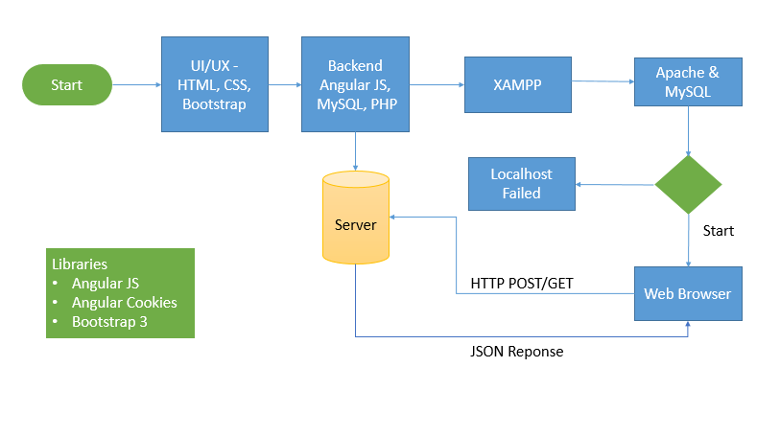
WORKFLOW DIAGRAM FOR WEB APPLICATION

Slide 13
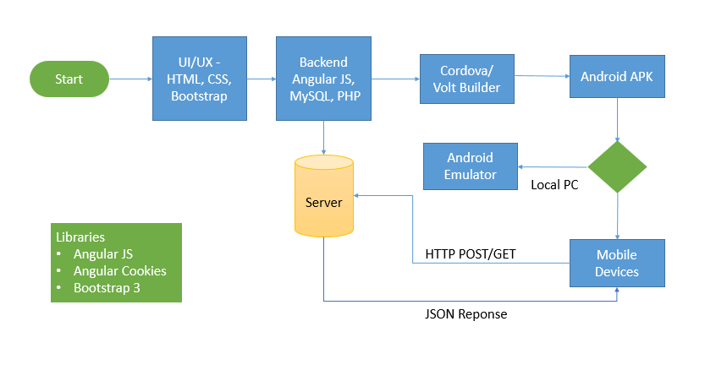
WORKFLOW DIAGRAM FOR ANDROID APPLICATION

Slide 14
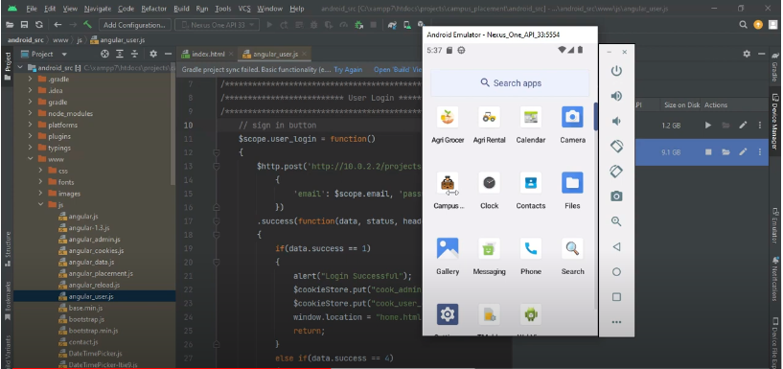
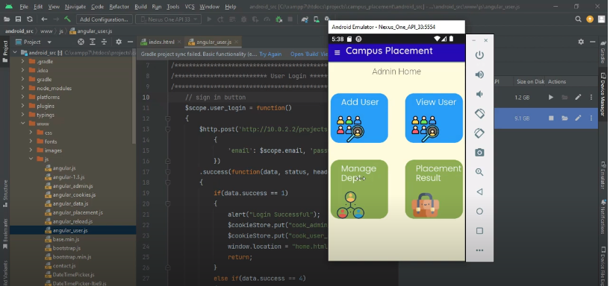
SCREENSHOTS

Slide 15
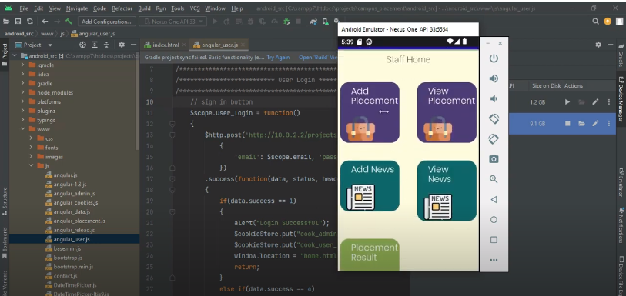
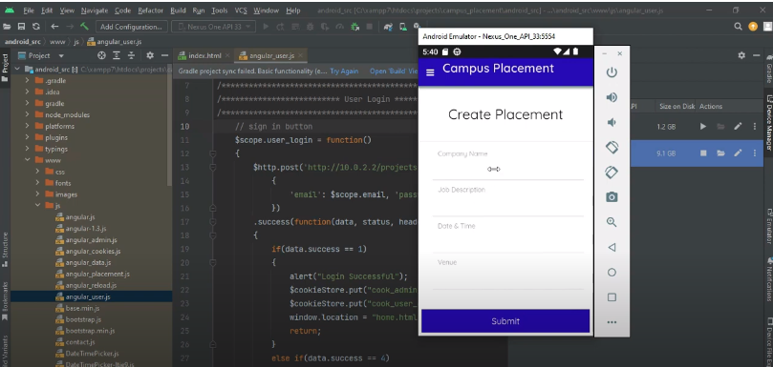
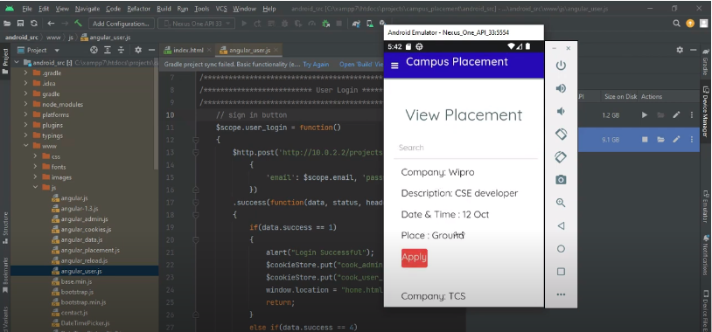
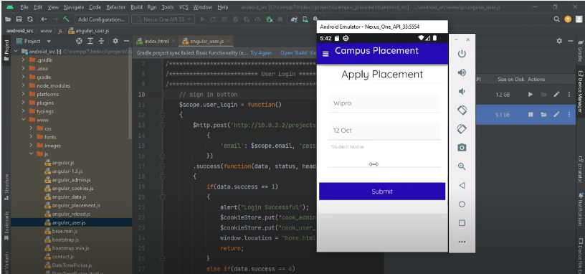

Slide 16
CONCLUSION
In conclusion, the "Campus Placement Recruitment System" revolutionizes the way campus placements are conducted and navigated. By providing a user-centric platform, it offers a range of benefits for students, educational institutions, and potential employers.
With features such as easy search and application for placement opportunities, convenient access to placement details, and ongoing career support this system ensures that students are empowered in their pursuit of opportunities.
The "Campus Placement Recruitment System" is a game-changer in the realm of campus placements, creating a positive impact on the future careers of students and the success of educational institutions.

Slide 17
FUTURE ENHANCEMENT
Implement predictive analytics and machine learning algorithms to analyze historical placement data and predict potential job matches for students based on their profiles, skills, and preferences.
Develop a feature that offers personalized career guidance to students, suggesting relevant courses, certifications, and skills development opportunities based on their career aspirations and the requirements of prospective employers.
Integrate the system with professional networking platforms like LinkedIn to allow students to showcase their profiles, achievements, and projects. Recruiters can then easily access comprehensive information about potential candidates.
Develop an intelligent notification system that sends personalized job alerts to students based on their preferences, skills, and career interests. This ensures that students are aware of relevant opportunities in real-time.

Slide 18
REFERNECES
Published in: International Journal of Innovative Technology and Exploring Engineering (ISSN: 2278-3075)Link to Paper
Authors: Sandeep Kumar, Kirti, Pawan Kumar
Published in: International Journal of Computer Applications (0975 – 8887)Link to Paper

